Slide 1
Care Home ECHO
Making the right thing, the easy thing to do
Image by rawpixel.com</a> on Freepik
Dr Michelle Beattie, Dr Kevin Muirhead, Dr Nicola Carey,
Centre for Rural Health Sciences
University of the Highlands and Islands
Notes:
Thank you for the opportunity to speak. Intro self, Centre for Rural Health. Nurse.
Purpose share with you the findings of our evaluation of Project ECHO in Care Homes.
Problem: Residents care has increased in complexity. This requires an educated care home workforce with access to specialist care when needed. This is not always easy due to workforce shortages within the care home sector and limited access to specialist support. Other services often don’t have the resource to support staff and residents in care homes.

Slide 2
ECHO
ECHO (Extension for Community Healthcare Outcomes)
Learning and support via videoconferencing
Developed in Mexico during Covid-19 (Katzman et al 2021)
ECHOs organised via ECHO superhubs – Highland Hospice
90 minutes duration
Topics agreed with care home staff
Weekly sessions for six weeks
Notes:
ECHO was originally developed to support the care of people living with Hepatitis C in remote areas. However, the model has since been used across over 100 complex conditions and over 45 countries¹

Slide 3
The ECHO Model
4. Case discussion & recommendations
for care
3. Care home worker presents resident's case
2.Question & Answer Session
1.Presenter gives an overview of topic
All teach, all learn ethos (The University of New Mexico, 2023)
Notes:
During ECHO sessions, experts at hub sites connect with local providers at spoke sites (e.g., care homes) via VC. A typical ECHO programme will run for 4 to 6 sessions of 60 to 90-minutes duration in which experts deliver a brief didactic presentation. Care home staff then present anonymised resident cases. Together, subject experts and care home staff discuss the cases and share recommendations for best practice. The continuous loop of learning, mentoring, and peer support makes ECHO unique compared to other online learning modalities¹³. ECHO is underpinned by an ‘all teach, all learn’ ethos¹⁴ and is underpinned by educational principles of Social Cognitive Theory¹⁵, Situated Learning Theory¹⁶, and Community of Practice Theory¹⁷ (Box 1). In summary, the ECHO methodology uses technology to spread expert knowledge to providers using case-based learning to enable best practice and reduce educational disparities.

Slide 4
Evidence and Gaps
A systematic review of the impact of ECHO found evidence that they improved participant confidence, changed behaviour, were cost-effective and, in some studies improved patient outcomes. Only two of the thirty studies included care home residents (Zhou et al 2016).
Included studies found that when behavioural plans were followed (supported by ECHO) hospitalisation was less common in residents (Catic et al 2014).
There is also evidence supporting the claim that ECHOs impact positively on healthcare professionals learning, including perceived knowledge and confidence to manage complex cases (McBain et al 2019).

Slide 5
Aim
To establish the perceived impact of ECHOs with CHWS, and to explore what factors are enabling and inhibiting implementation.

Slide 6
What we did
CHWs from two Scottish Health Board areas (Hub A and B) were part of Project ECHO.
ECHO Hub A - 44 participants over 5 ECHO sessions ECHO Hub B - 32 participants over 4 ECHO sessions.
3 focus groups for CHWs (n=13) plus
1 focus group for ECHO facilitators/presenters (n=6).
We followed Braun and Clark’s thematic analysis steps.

Slide 7
Findings
Inhibitors
Digital skills & Access
Learner Diversity
Duration
Limited Protected Time
Workforce challenges
Benefits to residents
Feeling valued & confident
Networking
Satisfaction with ECHO
Learning and Development Opportunities
Perceived Impact
Admin & Tech
Engagement
Scheduling
Convenience & Flexibility
ECHO approach
Protected time
Enablers

Slide 8
Perceived Impact
Benefits for residents
“I got to understand the key concept of what a perfect death is… They don't want to go to the hospital. So, it's very good, we now know when and how to assist them to die peacefully and erm, also to, to die by their own choice.” FG1, P4
“Don't know how to deal with somebody that's, that's delirious and, and acting in a way that you know, they find strange. And umm, there's, there's loads of techniques out there!” FG2, P1
Biting and kicking and nipping and it, it is horrible when she does really, but it’s cause she can't help it. The talk, (ECHO) some of the stuff they're saying like “oh we could try this or try that” FG1, P3

Slide 9
Perceived Impact
Networking
“I think just knowing, and getting to know people, contacts, resources that are out there”. FG2, P1.
Developing supportive relationships could install a sense of community and reduce feelings of isolation.
“It gave me that sense of, as everyone's been saying throughout, the sense of a community and a support network and that, you know, someone always had your back. And we're all in the same boat, essentially”. FG2, P4.
In some cases, participation in Project ECHO resulted in care home staff forming lasting professional relationships.

Slide 10
Enabling Factors
ECHO approach
“Nurse could put in their input, but then a carer could also put in their side of the story. So, you could get the full picture”. FG2, P4.
“I think that obviously the case studies were helpful to kind of, I suppose reassure everybody that we're all, you know, facing the same situations and it was helpful to have that spoken about in an open kind of forum … I think that the people who attended felt like part of the solution as well”. FG3, P1.
“The fact that it's interactive, that makes a huge difference to me personally. I'm very much one for sitting and reading books or sitting doing a module online, but the fact that you've got the opportunity to ask questions and network … that's invaluable”. FG3, P2.

Slide 11
Inhibiting Factors
Learner Diversity
A key consideration was in ‘getting the pitch’ right for the diverse audience. Presentations that were too high, or too low-pitched risked disengagement.
“Because it's trying to get that common language across everybody. So, we all know what we're talking about.” FG1, P1,
“The thing I found challenging was the real mix in the group. So, you had individuals from carers right through to people who were quite senior … So, you didn't want to be too complicated that people wouldn't engage, and you didn't want to be too simple that people would think oh she’s patronising us. FG4, P5.

Slide 12
Inhibiting Factors
Duration
Whilst ECHOs have a specified format some care home staff felt that the sessions were too long (1.5 hours).
“You know, half an hour is probably more doable for people to be honest.” FG3, P3
“I wonder if there's such a thing or a potential for an ECHO bite size.” FG3, P1
“It was sometimes quite difficult to put aside that amount of time to do it. So maybe a recorded feature or something like that where you could go back, and you could watch it in your own time.” FG2, P8.

Slide 13
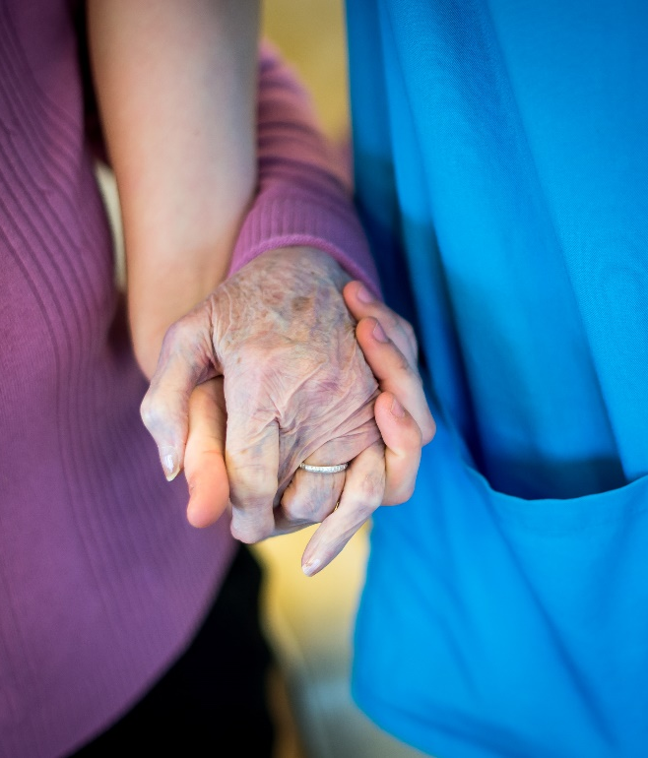
Key Points
To make it easy for care home staff to access specialist education and support (using ECHO) to care for residents they need:
- protected learning time for ECHO sessions.
- shorter ECHO sessions without compromising ECHO structure.
- administrative/technical support. Possible buddy system.
- to have equal access to educational opportunities regardless of role.
- to connect and build trust with staff from other care homes

Slide 14
Thank You
michelle.beattie@uhi.ac.uk
Twitter:
@BeattieQi

Slide 15
References
Catic AG, Mattison ML, Bakaev I, Morgan M, Monti SM, Lipsitz L. ECHO-AGE: an innovative model of geriatric care for long-term care residents with dementia and behavioral issues. Jn of the American Med Dir Assoc. 2014 Dec 1;15(12):938-42.
Katzman JG, Tomedi LE, Thornton K, Menking P, Stanton M, Sosa N, Harkins M, Katzman N, Liu J, Archer GR, Arora S. Innovative COVID-19 programs to rapidly serve New Mexico: project ECHO. Public Health Reports. 2021 Jan;136(1):39-46.
McBain RK, Sousa JL, Rose AJ, Baxi SM, Faherty LJ, Taplin C, et al. Impact
of project ECHO models of medical tele-education: a systematic review. J
Gen Intern Med. 2019;34(12):2842–57.
The University of New Mexico. About the ECHO Model 2023; Available at: https://hsc.unm.edu/echo/what-we-do/about-the-echo-model.html Accessed 23/09/23.
Zhou C, Crawford A, Serhal E, Kurdyak P, Sockalingam S. The impact of
project ECHO on participant and patient outcomes: a systematic review.
Acad Med. 2016;91(10):1439–61.

